Slide 1
Bitesize Physics Career Resources
Empowering girls in STEM careers: Actions across the whole school
Notes:
Welcome. My name is Jessia Rowson and I am a trainer for Physics Partners.
This video is part of a series of Bitesize Physics Careers resources available through the Planet Possibility physics careers programme.
These Bitesize careers sessions are designed for use by a group of teachers, for example in a team meeting. Each session consists of a short presentation and an activity. They should take around 15 minutes to work through.

Slide 2
Aims for this section
We will consider:
What can be done to support across the school to combat gender stereotypes
Notes:
We will be looking in the session at what can be done across the whole school to combat gender stereotypes.

Slide 3
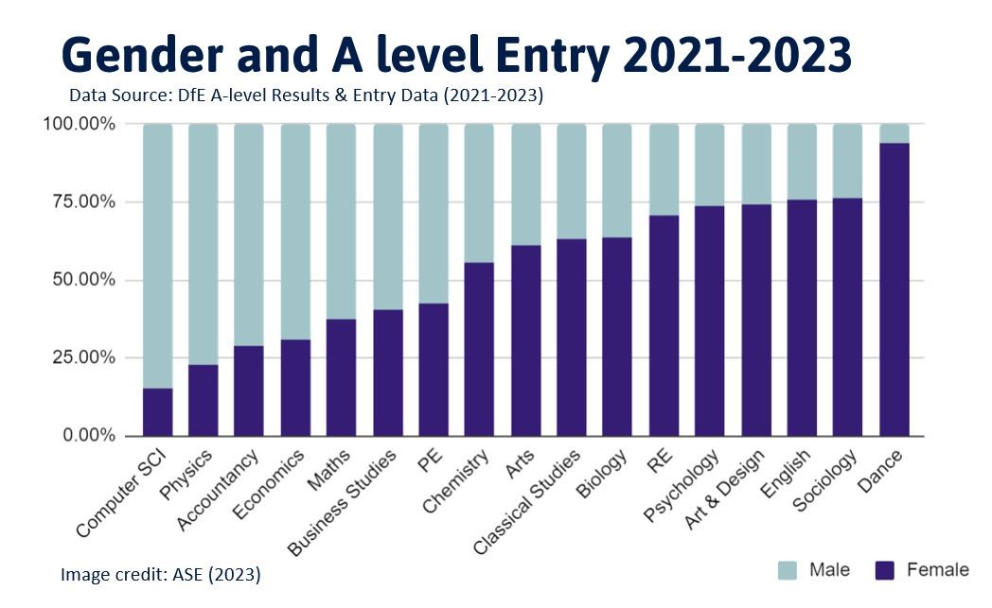
The Gender split
Notes:
Stereotypes can be harmful to everyone. It can affect children’s well-being and influence their life choices.
Physics isn't the only subject to be impacted by this. In the same way that girls can be put off from subjects like physics, computing and accouting, boys can be put off english, dance and art.
The opening doors project from the IOP showed that schools that have a large gender imbalance in physics also tend to see imbalances in other subjects like English and psychology, indicating that school environment has its part to play.

Slide 4
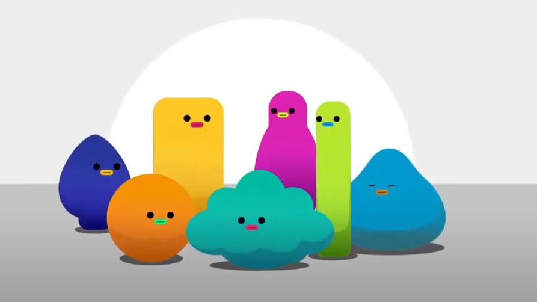
Countering stereotyping
Notes:
Being aware of stereotypes and how they can influence behaviour is one of the first steps in countering their impact.
You might like to pause here and watch the short video on Challenging Stereotypes, which has been produced by the Institute of Physics. This video could be used as a prompt for discussion in class. The link is in the resources handout.
There are also a number of other resources mentioned in the handout which are designed to run alongside this IOP video and raise awareness of stereotypes.
Take a minute to think about how the workshops could run in your school? (e.g. in tutor time, as drop-down days, during PSHE)

Slide 5
How gender equitable is your school?
Activity:
In groups, discuss what steps your school have taken to be gender equitable? If not, could steps be taken?
You might consider:
Have all school staff had training around gender awareness and the impact of stereotypes?
Is there a whole-school equity plan with someone in SLT responsible for it?
Is sexist language treated similarly to racist and homophobic language?
Does careers advice challenge gender stereotypes?
Is gender disaggregated data on both achievement and progression collected for all subjects?
Are initiatives carefully planned to address any problems shown in the school data?
Are subjects presented as equally challenging?
Are girls and boys sports teams given equal promotion?
Are students at the heart of the campaign to combat gender stereotypes?
Are sessions on equality and diversity included as part of the PSHE curriculum
(10 minutes)
Notes:
How gender equitable is your school? There are a number of steps that could be taken. This slide contains some questions that could be useful when doing a gender audit of your school. Read through them and discuss them in your group

Slide 6
Looking for further support from Physics Partners?
We offer:
Bitesize Careers Resources
Short teacher CPD videos
In-person training for non-specialist teachers
Festival of Physics CPD Days
Girls in STEM Days
Physics Study Days
Visit www.PhysicsPartners.com
or email info@physicspartners.com to find out more!

