Slide 1
Bitesize Physics Career Resources
Empowering girls in STEM careers: Actions for the science classroom
Notes:
Welcome. My name is XXX and I am a trainer for Physics Partners.
This video is part of a series of Bitesize Physics Careers resources available through the Planet Possibility physics careers programme.
These Bitesize careers sessions are designed for use by a group of teachers, for example in a team meeting. Each session consists of a short presentation and an activity. They should take around 15 minutes to work through.
This session is about tackling unconscious bias in the classroom.

Slide 2
Aims for this section
We will consider:
What might be happening in the classroom and what we can do to support
Notes:
In this section we will be considering what might be happening in the classroom and what we can do to support

Slide 3
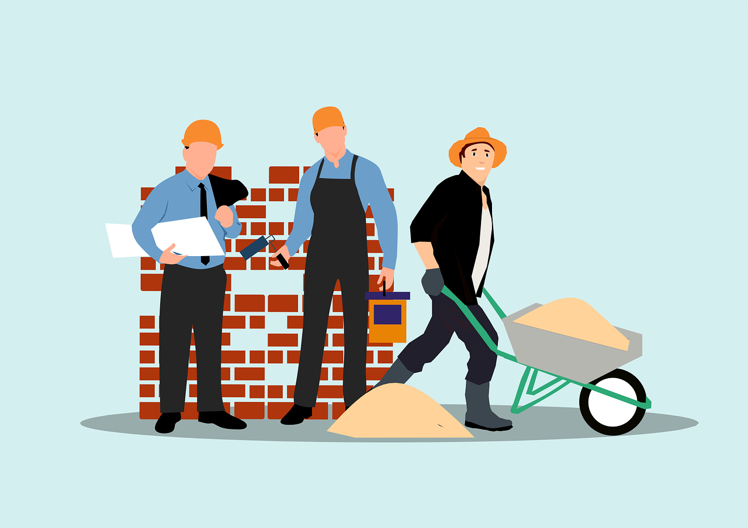
Stereotypes affect our brain
Unconscious bias can affect your behaviour if left unchecked
Notes:
In the session looking at why girls don’t choose physics, we consider some of the stereotypes that exist around gender and physics. In this session we will look at how some of those stereotypes might be affecting our behaviour as well as the behaviour of our students.
To understand what might be happening, we need to look to what is happening in our brains.
Our unconscious is a powerhouse and is constantly looking for patterns. Then when our brain is missing certain information, our unconscious will try and fill the gap based on patterns it has previously seen. For example, walking around, one might see a builder – male, a builder – male, another builder – also male, so when someone mentions a builder, an image of a man pops into your head, even when no gender is mentioned.
It is based on the sum of our experience, and so tends to assume stereotypical characteristics and behaviour of others.
However, everyone is an individual and our initial assumptions are often wrong. It does not make you a ‘bad’ person, but it is important to be aware of it and when it impacts your behaviour. When we are aware of it, we can manage its impact.
https://pixabay.com/vectors/construction-building-business-work-8574908/
Image by Mohamed Hassan from Pixabay
https://www.shutterstock.com/image-photo/brain-puzzle-pieces-inscriptions-bias-2075174725
Photo by Robina Weermeijer on Unsplash

Slide 4
Unconscious bias in the classroom
Our unconscious biases can play out in the classroom if left unchecked.
Researchers found that:
Teachers can spend more time talking to male students
Teachers tend to direct their gaze to boys more often when asking open- ended questions
Teachers tend to acknowledge girls, but praise and encourage boys
Teachers may prompt boys to seek deeper answer, while girls are rewarded for being quiet
Girls work tends to be praised for its appearance while boys work is praised for its content.
Notes:
Our unconscious biases can play out in the classroom if left unchecked.
Researchers found that:
Teachers can spend more time talking to male students
Teachers tend to direct their gaze to boys more often when asking open- ended questions
Teachers tend to acknowledge girls, but praise and encourage boys
Teachers may prompt boys to seek deeper answer, while girls are rewarded for being quiet
Girls work tends to be praised for its appearance while boys work is praised for its content.
These behaviours, where they exist, in combination with students own perceptions on gender and physics, can all add up to additional barriers for female students

Slide 5
What can we do?
Inclusive classroom
Enable all to participate (e.g. no hands up, think-pair-share, whiteboards)
Challenge any anti-inclusivity
Monitor your interactions
Make the learning relevant
Relate context back to everyday life and careers
Show that a diverse range of people do physics
Vary contexts (not just cars and football)
Make physics accessible
Model making mistakes
Use everyday language
Build numeracy and literacy
Notes:
So what can we do in the classroom?
Firstly let’s think about how to create an inclusive classroom. Less confident students will tend not to put their hands up or volunteer, as they don’t want to get the answer wrong, so think about how to manage your classroom so everyone can participate in a low stakes way. Think pair share allows quieter students to share their thoughts with another in a safe environment. Challenge any comments and don’t accept it as banter. And monitor your own interactions, now that you are aware of unconscious bias. These ideas all come from the Institute of Physics who have done a great deal of work looking at what we can do to support students of all genders in the classroom. Please refer to the resources sheet for more information
Secondly, make learning relevant to your students. Relate the context back to their everyday life and show that a diverse range of people do physics.
Lastly, make physics accessible, and show that making mistakes is a part of learning and nothing to be frightened of. Understand what might give physics the appearance of being ‘hard’ and introduce the maths and the vocab with plenty of scaffolding and support.
It’s also important to note what research says doesn’t make a difference in the classroom. Occasional female scientist guest speakers don’t make a difference as students often perceive them as ‘one-offs’ and so not like them. The gender of female physics teachers also doesn’t make a difference – it’s the supportive relationship between students and teacher that makes the difference. What has been shown to make a difference is talking about women scientists and why we don’t see so many female scientists

Slide 6
What can we do in the classroom?
Activity:
Look back at slide 5.
What from this list are you already doing in the classroom? (3 minutes)
What ideas from this list could you incorporate into your classroom practice? (3 minutes)
What ideas do you think would be most difficult to incorporate? Why? (3 minutes)
Notes:
Now its time for you to consider what you can put into practice.
Look back at slide 5.
What from this list are you already doing in the classroom?
What ideas from this list could you incorporate into your classroom practice?
What ideas do you think would be most difficult to incorporate? Why?
We hope you have found this session useful. Please take a look at the other bitesize sessions.

Slide 7
Looking for further support from Physics Partners?
We offer:
Bitesize Careers Resources
Short teacher CPD videos
In-person training for non-specialist teachers
Festival of Physics CPD Days
Girls in STEM Days
Physics Study Days
Visit www.PhysicsPartners.com
or email info@physicspartners.com to find out more!

