Slide 1
Bitesize Physics Career Resources
Empowering girls in STEM careers: Why girls don’t choose physics
Notes:
Welcome. My name is Jessica Rowson and I am a trainer for Physics Partners.
This video is part of a series of Bitesize Physics Careers resources available through the Planet Possibility physics careers programme.
These Bitesize careers sessions are designed for use by a group of teachers, for example in a team meeting. Each session consists of a short presentation and an activity. They should take around 15 minutes to work through.

Slide 2
Aims for this section
We will consider:
The factors that may put off female students from taking physical sciences
Notes:
In this section we will be looking at some of the factors that may put off female students from taking physical sciences

Slide 3
How popular is A-level physics?
Maths 89,605
Biology 66,220
Physics 36,770 (9th most popular)
Why do people choose A-level physics?
Encouragement by a key adult
Job satisfaction/salary rewards
Confident in the subject/well-taught
Notes:
Firstly, let's look at who chooses to takes physics. Using the A-level data to give a picture of the situation in England, we can see in 2022 only 36,770 students chose to take physics in comparison to 66,220 students choosing to take biology at A level. Physics was the 9th most popular subject overall.
Researchers at the Institute of Education looked into the factors that influence a student to take the physical sciences post 16 and found that there are 3 thing that make young person more likely to continue maths and physics post-16:
If they have been encouraged to do so by a key adult – either a family member who believes in the worth of these subjects, or a teacher;
If they believe they will gain from studying the subject in terms or job satisfaction or material rewards such as a good salary;
If they are good at the subject or have been well-taught.

Slide 4
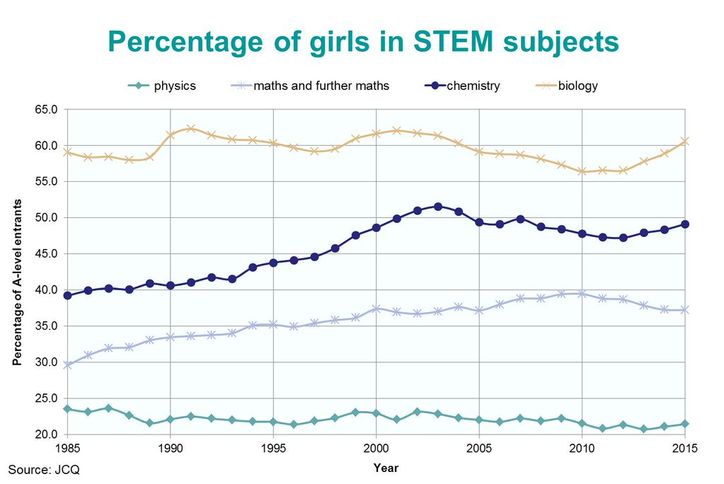
What is the current gender balance?
Notes:
If we look at the gender balance of those studying physics, we can see that around 20% of physics A level students are female, and this has been the same proportion for the last 20 years. The gender balance of those studying Maths and further maths is slightly better, chemistry is approaching the 50/50 mark and biology attracts more girls than boys.

Slide 5
What might put girls off?
They don’t know what they can do with physics A-level
Lack of careers advice
They think physics is hard; confidence issues
They don’t see physics as ‘for them’
Physics is seen as a boy thing
Notes:
So what are the factors that might be putting girls off physics? Firstly, research shows that girls tend to plan further ahead than boys and are looking to what might be useful for them in their career. We are often keen to tell students that they could be engineers or scientists, but sometimes students might get the wrong idea and think that’s the only thing they can do with physics. The other sessions in this bitesize careers series are looking at what can be done in relation to this.
Secondly, Physics is associated as being a male interest and thirdly. Physics has an image problem – it is seen as hard, and girls tend to underestimate their abilities compared to boys. We will look at these later two issues further.

Slide 6
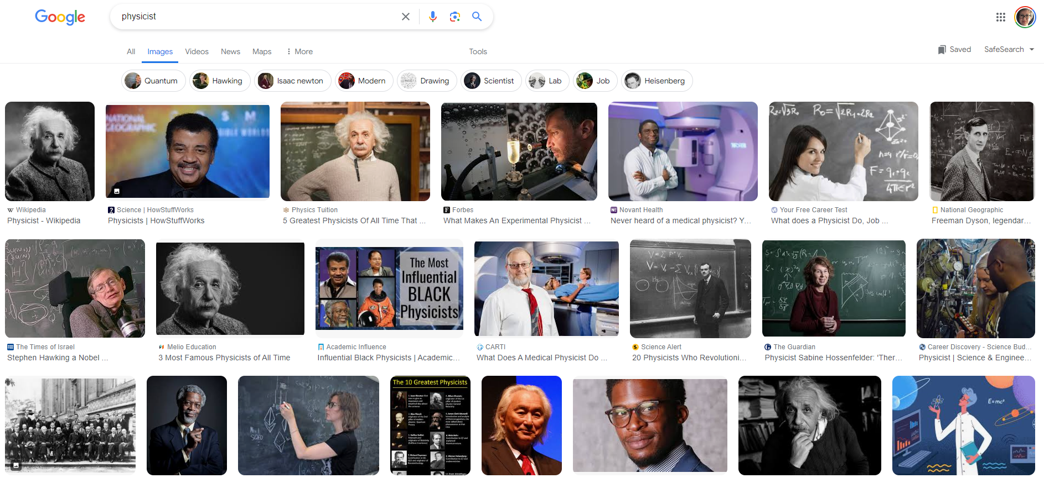
Google search of ‘physicist’
Notes:
This slide shows a google image of the word ‘physicist’. When most of the physicists you see are male and have white hair, you tend to associate physics with old men. Girls, particularly those that identify as ‘girly girls’ therefore have additional work to do to reconcile their personal identity with that of physics.
There is also a societal unconscious bias that men are smart and physics is hard which puts another mental barrier in place. Even as young as 6, girls tend to identify boys are more ‘smart’
Pass rates are often low in physics with the expectation that students will struggle to get all questions correct, giving the impression that physics is hard.
A girl’s confidence drops in her teens. She is more likely to see anything less than perfection as a failure. Rather than ‘fail’, they opt out.

Slide 7
Stereotypes about physics and gender
Discussion activity:
Is physics harder than other subjects? Why might students think this? What can be done in the classroom to address this stereotypical viewpoint? (3 minutes)
Are boys cleverer than girls? Why might students think this? What can be done in the classroom to smash this stereotype? (3 minutes)
Watch the video
Were you surprised by the reactions of the people in the video? Reflect on whether you might have made any assumptions based on someone’s gender or whether someone has ever made an assumption about yourself based on your gender? How might these assumptions play out in the classroom? (3 minutes)
Notes:
On this slide are a number of discussion points from this session for you to look at as a group. Please see the resources handout for further guidance.
We hope you have found this session useful. Please take a look at the other bitesize sessions.

Slide 8
Looking for further support from Physics Partners?
We offer:
Bitesize Careers Resources
Short teacher CPD videos
In-person training for non-specialist teachers
Festival of Physics CPD Days
Girls in STEM Days
Physics Study Days
Visit www.PhysicsPartners.com
or email info@physicspartners.com to find out more!

