Slide 1
Embedding physics careers in the curriculum: Planning for careers

Slide 2
Aims for this session
We’ll be aiming to look at:
Planning for careers in your classroom and department
Notes:
This outlines what will be covered during the session.

Slide 3
Careers in YOUR classroom
Why careers in your classroom?
It doesn’t have to be a special ‘careers lesson’ – more opportunities for students to hear about different pathways
Practice at ‘application’ of subject knowledge
Notes:
Teachers never feel that they have enough time to cover everything that they need to do in the curriculum.
Therefore, taking time out to do a special ‘careers lesson’ feels like wasted time.
However, as part of their planning, they can include careers as part of their normal teaching.
There are two advantages to this: firstly it improves their students knowledge of careers and there are more opportunities to ‘drip feed’ information to students., and secondly, with the increase of ‘application’ in the new GCSEs exam questions are going to include more examples of unknown situations that students will not have come across before.
Therefore, by including more contexts and examples linked to curriculum content, students will get used to a wider range of examples and become more comfortable with applying their subject knowledge in different ways.

Slide 4
Planning for careers
Department time to identify possible links
Careers prompt in schemes of work
Identify ‘real life’ applications of topics
Displays
Notes:
It’s important to plan for careers information in the curriculum, rather than trying to think of things during a lesson.
Possible ways to plan:
Could be by looking at schemes of work as a department to highlight a careers link once a week (or other timescale).

Slide 5
Planning for careers
Make use of parents and families:
What links do your students already have?
To what companies/sectors?
Use your alumni network – links with Future First
Enterprise Adviser Network / STEM ambassadors
Notes:
On a larger scale, schools can also look at the resource they have outside of the school.
In their parent / family body. They will have people who work in a range of companies and sectors. How can this be pulled out? In individual classrooms, or perhaps as a display, or even parents coming in to speak to teachers or pupils about their work.
What about their past pupils? Universities make good use of their alumni. Why don’t schools? Some schools already ask students who have gone to university or into an apprenticeship to come back and talk to pupils. Perhaps you can have a ‘where are they now’ display with information about students and their career choices.
The Careers and Enterprise Company (funded by the government) run an enterprise adviser network which links schools with senior leaders in companies.

Slide 6
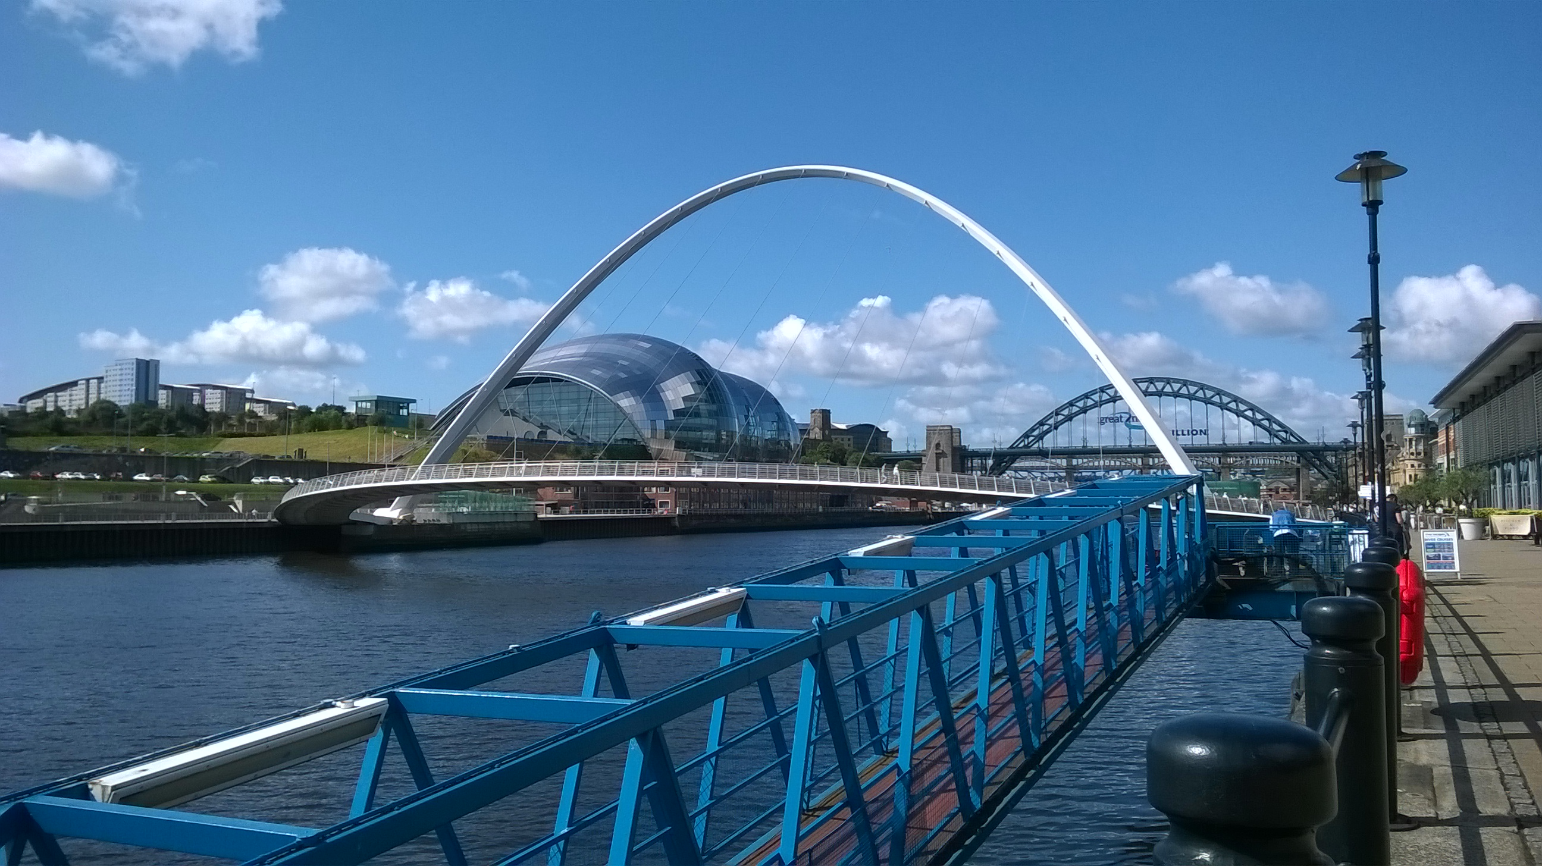
Activity 1:
Example: Gateshead Millennium Bridge
Think of one of the last physics lessons you taught.
Now come up with link(s) between their lesson and this picture.
Could you ask pupils to do this? It wouldn’t have to be a picture which is directly linked to the topic – science and maths are such an inherent part of life that the teachers and pupils should be able to come up with the different links.
What careers might be involved in what they can see in the picture.
(5 minutes)

Slide 7
Possible relevant areas of science or maths
Forces – resolving
Moments
Material properties
Corrosion
Friction
Waves
Shape and angles
Potential career links:
Architect
Designer
Materials scientist
Lighting designer
Steel fabrication
Construction
Structural engineer
Electrical engineer
Accountants
Public Relations
Notes:
This slide has possible areas of science and maths, and potential career links.
Teachers may have thought of more that link in to something in the picture.
In many ways, it doesn’t actually matter what links the pupils (or teachers) come up with. We are forcing them to try and find connections between science/maths and what they are learning.

Slide 8
Activity 2:
Using the internet, find a local image that pupils would recognise.
What physics topics could you link to it and what careers might that suggest?
Make some notes so that you can share your ideas with the group
Could this type of activity be embedded in your physics curriculum?
(5 minutes)

Slide 9
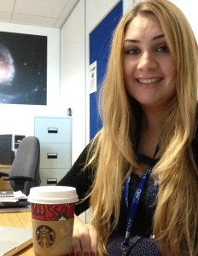
Think about your examples…
Astrophysicist
Nurse
Alyssa Drake – astrophysicist currently working in Germany
Ian Maude, Auxiliary Nurse
Notes:
A quick exercise to highlight the first thoughts that students might have.
Befpre you click to reveal the images beneath the occupations, ask them to sketch or describe what these two people might be like – their characteristics.
Links to gender and diversity

Slide 10
Display
Display board at a library.
What does this say to children and young people?
https://www.flickr.com/photos/58212595@N00/354510876/

Slide 11
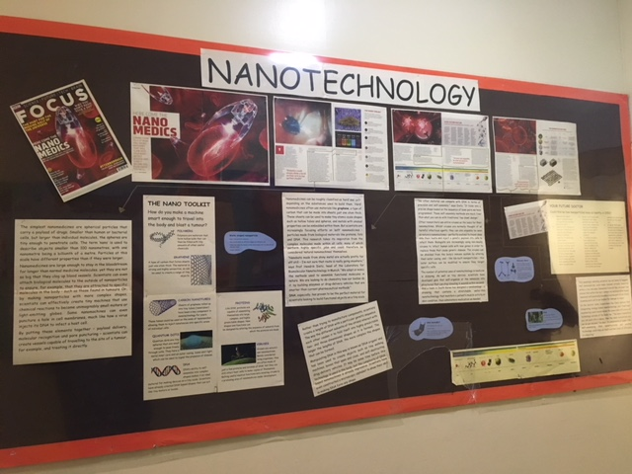
Nice example: Used an article from Focus magazine – but typed up the information
Credit: DawnatLMS
Notes:
Nice example: Used an article from Focus magazine – but typed up the information
“I'll let you into a secret of creating a great board with minimal effort - use already published material. On this board we have taken the Focus magazine and re-typed the information. There are a number of reasons we do this:
1) make the material bigger
2) we are a dyslexia accredited school so all displays have to be in comic sans on yellow paper.
3) leave the original article there to show it is someone else's work!
4) make it more display friendly.
For each part of the article I have included an arrow showing that the information is there is a larger format. This also means small articles can fill large boards but don't be misled, all of the information is interesting and valid - not just a 'filler'. All of the items on the board are part of the original article.
I did a similar board to this on photosynthesis where the board started for low level but then included a reproduced article as an extension for upper school.
Another place I find good material is First News - the newspaper for kids. They have basic information in an interesting article that I photocopy, display and also reproduce in large readable font but then I can also add info from the science curriculum in support.
Please do be aware that often when articles are used in displays they are unreadable. We do this kind of thing for all of out science in the news boards now. However, always display the magazine you use so that the pupils are encouraged to go away and read!”

Slide 12
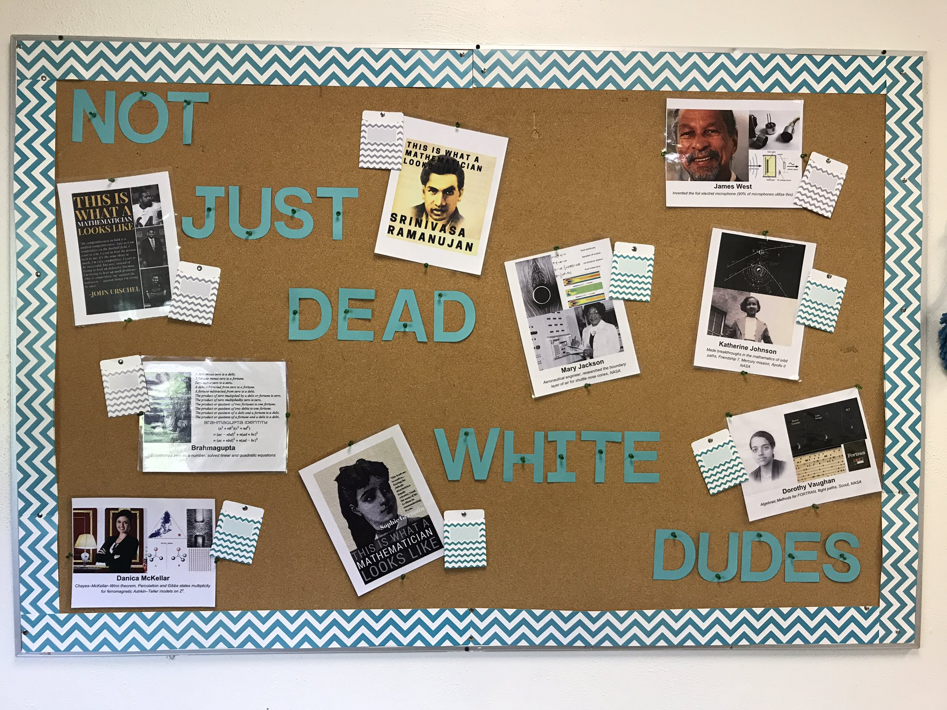
Credit: Elissa Miller @misscalcul8
http://mrhowardlearningtoteach.blogspot.co.uk/2017/08/i-created-these-posters-to-show-my.html

Slide 13
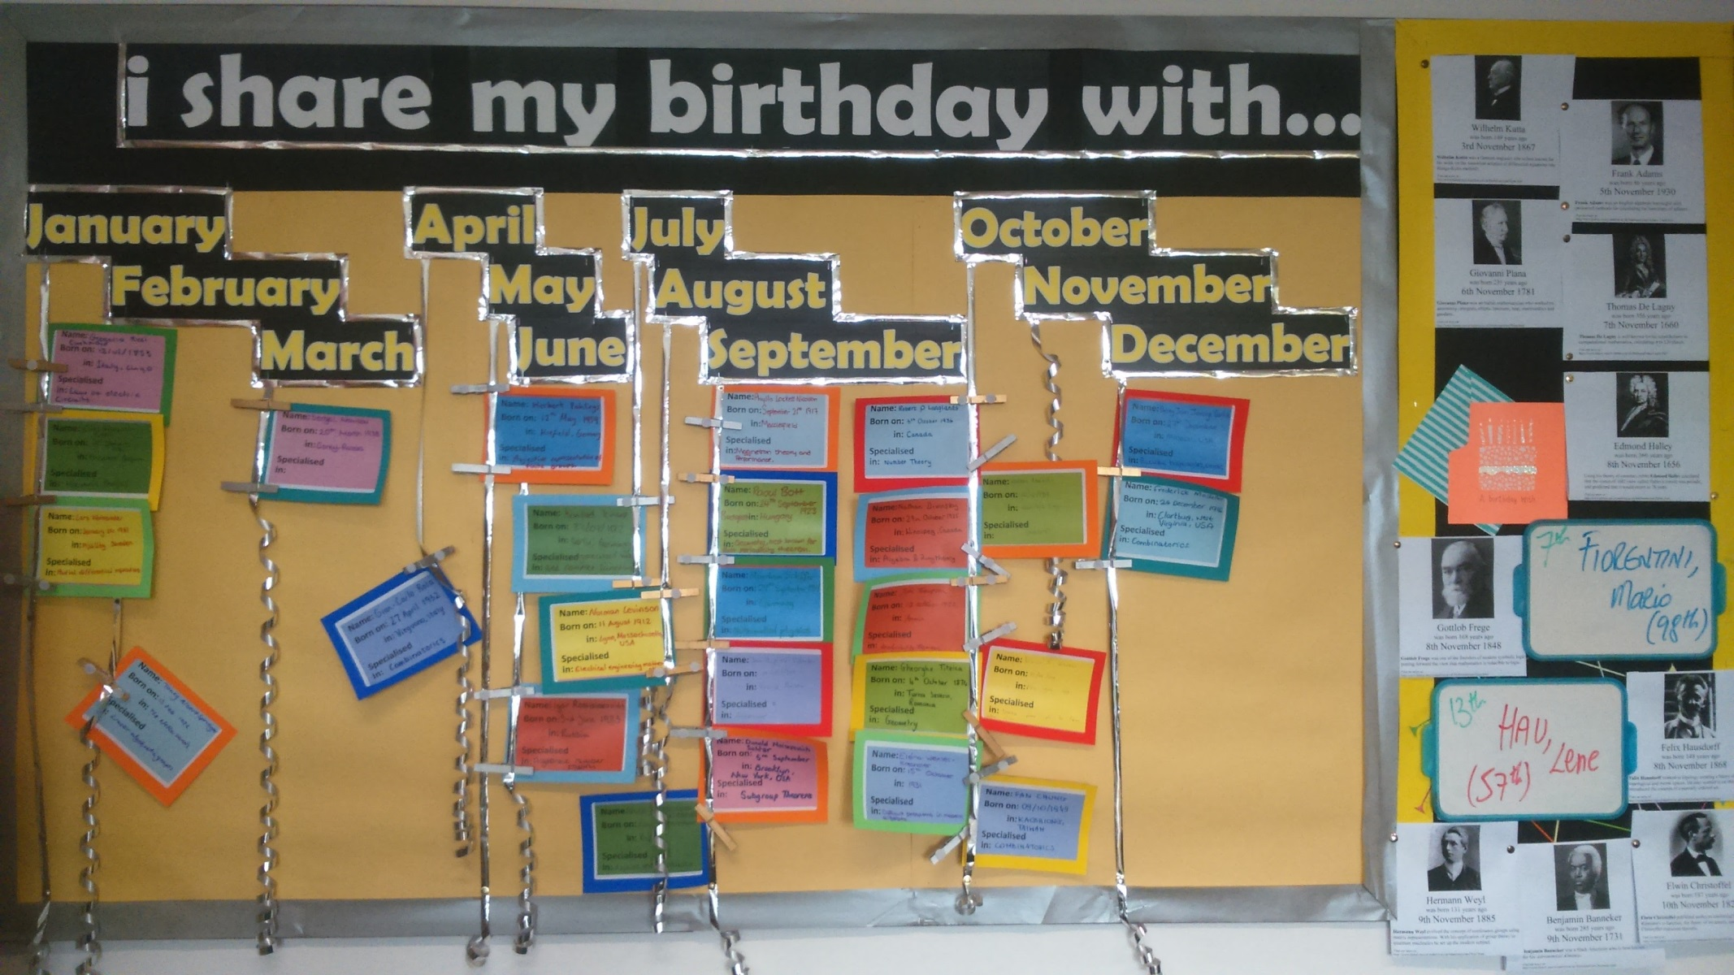
Another example from STEM learning – students research a mathematician (but could be any subject) that they share their birthday with.
Credit: ruri4770, Longley Park Sixth Form College
Stemettes
Women into Science & Engineering
Today in Science
Famous women scientists
Influential women in physics from the last 10 years
Notes:
Another example from STEM learning – students research a mathematician (but could be any subject) that they share their birthday with.
http://historywoman.weebly.com/birthdays.html
https://www.thoughtco.com/famous-women-scientists-3528329
https://todayinsci.com/5/5_08.htm
https://stemettes.org/
https://www.wisecampaign.org.uk/
https://academicinfluence.com/rankings/people/women-scholars/physics

Slide 14
Print out some examples of the tweets and hand around.
#actuallivingscientist
#ilooklikeanengineer
#iamaphysicist
Credit: @Alby
Notes:
Print out some examples of the tweets and hand around.
Another display, this time showing tweets from the ‘#actuallivingscientist hashtag on twitter. Alby has collected them and put them into a google drive that teachers can print out from. The picture is hyperlinked to the storage that Alby put together.
https://photos.google.com/share/AF1QipP-ikvlt4edaCPhop_iT63pMXCpLrDuWZP5i0ITneHulRyPtuNOeyAhB4kK9DZdtA?key=b0Vvdk5FS19sNURIMXRCN2F4NkhHb0lCMnVLQ05n

Slide 15
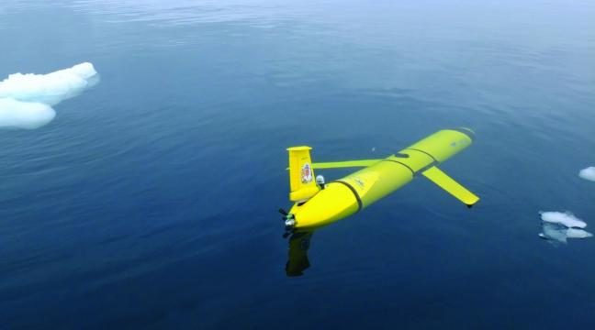
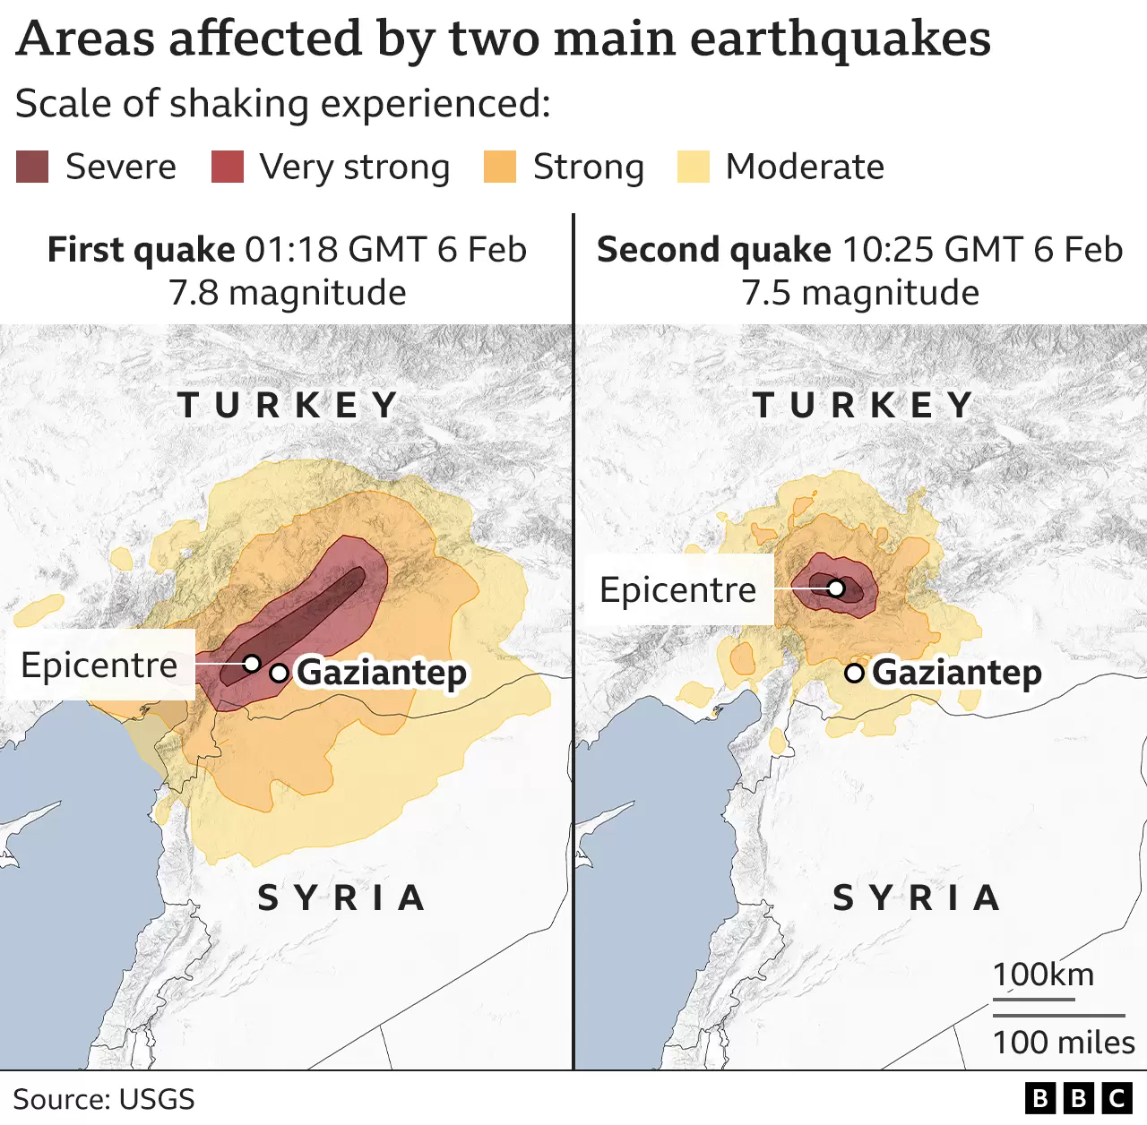
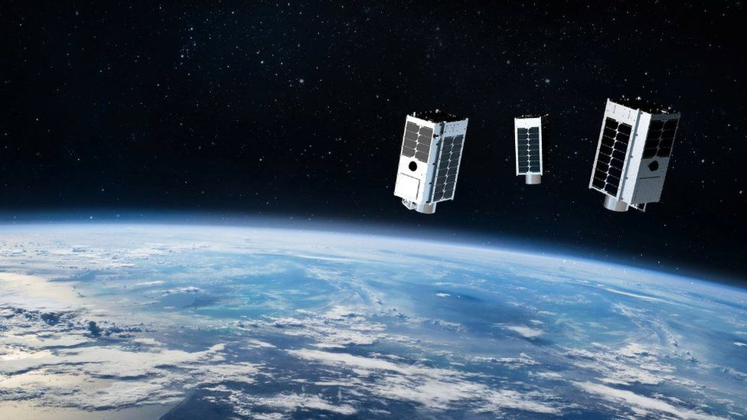
Questions, questions…
Use careers, companies and news stories as contexts for questions
Example news items
Turkey earthquake: Where did it hit and why was it so deadly?
GHGSat: Commercial satellite will see CO2 super-emitters
Notes:
Give out an example question sheets.

Slide 16
Showcase local companies
Notes:
Some of these slides are based on resources kindly provided by NUSTEM They are based in the North East. For further information follow the link below:
https://nustem.uk/careers/
How could you showcase local companies?

Slide 17
Next steps
To review, we’ve looked at:
Planning for careers in your classroom and department
Activity 3:
What will you do to add careers ideas into your subject teaching…
…tomorrow?
… next week?
… next term?
Do some simple action planning about ideas you can put into practice.
(5 minutes)

Slide 18
Looking for further support from Physics Partners?
We offer:
Bitesize Careers Resources
Short teacher CPD videos
In-person training for non-specialist teachers
Festival of Physics CPD Days
Girls in STEM Days
Physics Study Days
Visit www.PhysicsPartners.com
or email info@physicspartners.com to find out more!

