Slide 1
Embedding physics careers in the curriculum: Roles in careers provision

Slide 2
Schools’ statutory duty
Schools should secure independent careers guidance for all year 8 – 13 pupils.
Schools should help every pupil develop high aspirations and consider a broad and ambitious range of careers.
Notes:
The background to a school’s career provision. The statutory duty of schools in England, paragraph 9 from: https://assets.publishing.service.gov.uk/government/uploads/system/uploads/attachment_data/file/440795/Careers_Guidance_Schools_Guidance.pdf
Schools must provide external advice and guidance as part of their legal requirements – it can’t all be in-house, and it can’t all be online.
The independent advice must be
presented in an impartial manner
include information on the range of education or training options, including apprenticeships and other vocational pathways
is guidance that the person giving it considers will promote the best interests of the pupils to whom it is given

Slide 3
Aims for this session
We’ll be aiming to look at:
Career guidance in the UK
The role of subject teachers
Notes:
This outlines what will be covered during the session.

Slide 4
Activity
Looking back . . .
Who or what influenced your career decisions and the choices you have made?
(3 minutes)
Notes:
Think about your career progression. How did you make decisions about your career and who influenced you?

Slide 5
The role of subject teachers
“We found that young people are more likely to continue with mathematics and/or physics after the age of 16:
If they have been encouraged to do so by a key adult (usually in their family or at their school);
if they believe that they will gain from studying the subject in terms of job satisfaction and/or material rewards;
if they can manifest conceptual understanding in the subject(s); and
if they have been well taught.”
Mujtaba et al., 2012
Notes:
Start by reviewing the research that has been carried out into why students choose subjects. Research from the University College London UPMAP project looked at why pupils either chose or dropped maths and physics.
Four key findings emerged. Only one of those reasons is closely linked to ability in the subject.
Point out:
Key adults are an important indicator of what pupils will choose – that key adult might be parents, relatives or teachers.
Knowing what the subject is used for (or how much they might earn doing it) was also found to lead to choosing that subject.
And finally – having a good teacher who teaches well is also important! In fact, the 2013 Wellcome trust monitor found that the quality of the teacher was mentioned most often when pupils were asked what encouraged or discouraged them when learning science

Slide 6
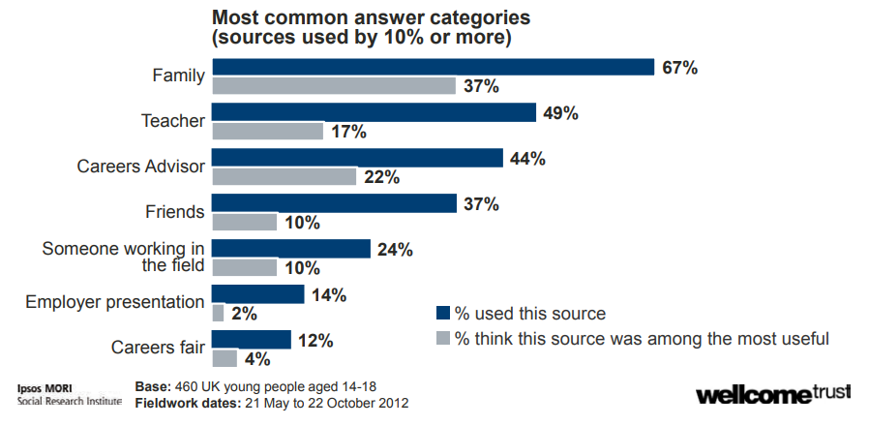
Wellcome Trust Monitor, 2013
Notes:
This graph is taken from the Wellcome trust monitor in 2013 – a survey of adults and young people about attitudes to science.
The questions asked were ‘Have you ever received information, advice or guidance about what you may do for a career from any of the sources? And ‘Which of the following have been most useful in helping you think about what you want to do as a career.’
Again, family is the most used, and perceived to be the most useful, source of IAG.
Teachers and careers advisors are used to a similar level, although careers advisors are seen to be slightly more useful.
Even with independent advice, young people find the information and guidance given by teachers useful.

Slide 7
Advice or information?
Teachers might have some concerns that they don’t know much about the careers linked to their subject, particularly if they graduated some time ago, or if they when straight into teaching from university. Watermeyer et al (2016) interviewed 94 teachers about providing careers information and guidance.
There were a range of viewpoints, and whilst many of the teachers recognised their role as being important, there were also concerns that they might provide biased or incorrect information.
They are also not independent, and so a school which relied on teachers to provide careers GUIDANCE would not be meeting their statutory duty. However, career choice is a process, and the more information and options that are presented to young people, then the more likely they are to be able to identify a career which they would enjoy and succeed in.
Notes:
The key point here is for teachers to be part of the careers guidance for young people and teachers should not shy away from this important aspect of their role.

Slide 8
Looking for further support from Physics Partners?
We offer:
Bitesize Careers Resources
Short teacher CPD videos
In-person training for non-specialist teachers
Festival of Physics CPD Days
Girls in STEM Days
Physics Study Days
Visit www.PhysicsPartners.com
or email info@physicspartners.com to find out more!

