Slide 1
Bitesize Physics Careers Resources
Where physics study can take you:
Physics careers resources

Slide 2
Aims for this session
We will consider:
Resources that can support physics careers information and guidance

Slide 3
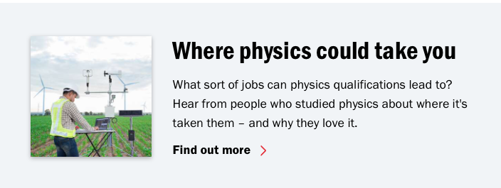
Considering physics related careers
It is important to convey to young people that physics opens doors to many careers.
There are many careers resources available to reflect the diversity of physics related careers.
Physics is an integral part of GCSE Science but when students consider their options, GCSE Physics (or equivalent) will be better preparation for further study.
Direct your students to resources on the IOP website:
https://www.iop.org/careers-physics/your-future-with-physics/career-paths
Notes:
Note in the script that there are links to suggested resources in the handout for this session.
https://www.iop.org/careers-physics/your-future-with-physics/career-paths

Slide 4
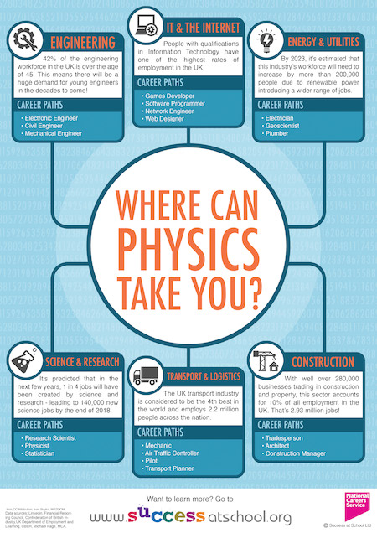
Other resources such as Success in School provide some useful background:
https://successatschool.org/advicedetails/394/Careers-in-Physics-Where-Can-Physics-Take-You%3F
Notes:
https://successatschool.org/advicedetails/394/Careers-in-Physics-Where-Can-Physics-Take-You%3F Remove this slide and just have links in the handout.

Slide 5
Engineering Careers
Engineering forms one of the largest physics related occupations and there a many different types of engineer.
There are also many resources available to provide specific careers advice on engineering.
The Tomorrow’s Engineers, Neon and Big Bang programmes led by EngineeringUK, provide excellent overviews of the many different engineering opportunities as well as more specific careers guidance and inspiration activities.
Notes:
Copy links into chat
Engineering Careers
www.tomorrowsengineers.org.uk/
https://neonfutures.org.uk/resource/
https://www.thebigbang.org.uk
https://mtfy.org.uk/
Tomorrow’s Engineers, led by EngineeringUK, brings together resources to support practitioners in getting the most out of their engagement activity.
Neon helps primary and secondary teachers introduce their students to future STEM careers, raise their aspirations and explore the excitement of engineering through brilliant activities, inspiring case studies and supportive resources.
The Big Bang, a STEM fair aims to encourage and inspire young people from groups who are under-represented in the engineering profession, and will be open to groups from state-funded schools for young people in:
England and Wales: year 6 to year 8
Northern Ireland: year 7 to year 9
Scotland: P7 to S2
The Fair has been designed specifically with this age group in mind, to provide the best careers inspiration, advice and opportunities to meet with real scientists and engineers.
Registration for The Big Bang Fair will open in January 2023, we can't wait to see you there - you won't want to miss it.
The Big Bang Competition is free, and is open to young people in the UK aged 11 to 19 in state funded education, who are home educated or who enter as part of a community group. Competitors can only enter one project, either on their own or as part of a team.
The Big Bang at School helps schools to host an inspiring STEM day filled with science and engineering activities, workshops and project work.
Meet the future you helps young people understand what an engineer does? By asking questions like a short quiz it can help them make career choices.

Slide 6
The Royal Academy of Engineering (RAEng)
The RAEng ‘This is Engineering’ programme also provides some inspirational information about the diverse range of opportunities in engineering as well as a range of free resources for schools.
This is Engineering
https://www.thisisengineering.org.uk/
Notes:
Are we going to play this video in the video?! If not I think remove it and tell them about it in the script

Slide 7
Skills Builder
Skills are also essential for any physics related career and the Skills Builder programme can help young people develop these through its Skills Builder Framework.
The Skills Builder Universal Framework is a transformative approach to building the essential skills of individuals throughout their lives, in education and employment.
Powered by 800 leading organisations across education and employment, the Framework has now been backed by the UK government in statutory guidance.
Notes:
Skills Builder
https://www.skillsbuilder.org

Slide 8
STEM Learning
STEM Learning provide a wealth of information about STEM careers more widely and there are links to many opportunities on their site as well as access to STEM ambassadors who are communicators and relatable role models who can help to provide careers guidance.
Notes:
STEM Learning
https://www.stem.org.uk/news-and-views/news/stem-careers-–-where-start?gclid=Cj0KCQjwgO2XBhCaARIsANrW2X2todnUyceLuXeL-23Jv29EMkAnqBiellEHv3TOa-GggEjQgPja594aAonUEALw_wcB

Slide 9
Future First
Future First is the only UK education charity connecting state school and college pupils of all backgrounds and abilities, to former students they can truly relate and aspire to.
Former students act as role models to highlight a range of career and education opportunities.
Notes:
Too much text. Some of it needs to be in the script.
Future First
https://futurefirst.org.uk

Slide 10
Activity
Review the physics resources presented in this session.
Are there any that might be particularly useful to use in your department?
How will you share them with your colleagues?
Notes:
Too much text. Some of it needs to be in the script.
Future First
https://futurefirst.org.uk

Slide 11
Looking for further support from Physics Partners?
We offer:
Bitesize Careers Resources
Short teacher CPD videos
In-person training for non-specialist teachers
Festival of Physics CPD Days
Girls in STEM Days
Physics Study Days
Visit www.PhysicsPartners.com
or email info@physicspartners.com to find out more!

