Slide 1
Bitesize Physics Careers Resources
Where physics study can take you:
Routes into physics related occupations

Slide 2
Aims for this section
We will consider:
The routes into physics-related occupations at various skill levels

Slide 3
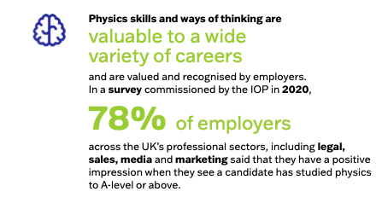
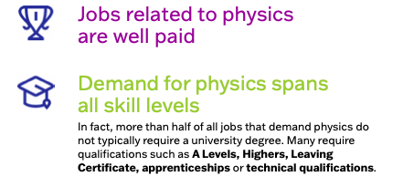
The benefits of studying physics
IOP Limitless Campaign
https://www.iop.org/strategy/limit-less#gref
Notes:
Young people and their families need to know the positive benefits of continuing with physics. This could be either through study or an apprenticeship or technical role. They need to know that studying physics doesn’t narrow career opportunities but opens doors to jobs in many sectors.
More also needs to be done to make sure young people know about the contribution that physics makes to our society and the opportunities it gives them to change their world.

Slide 4
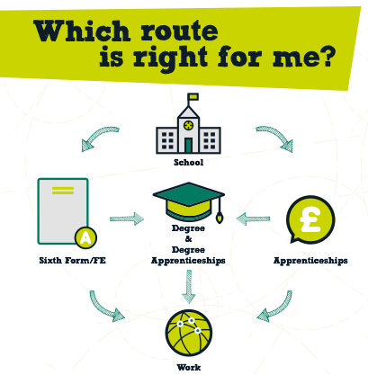
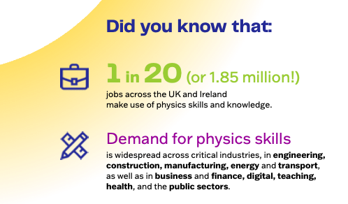

Slide 5
Routes from school into physics occupations
At age 14
If students are interested in STEM related careers they should focus on maths and science, particularly GCSE Physics
At age 16
If students have 5 GCSEs at grade 9 to 4 (A* to C) or equivalent, including maths, science – particularly physics – and English, they could:
Apply for an Advanced Apprenticeship which may involve study for a Tech Level whilst developing skills through work
Take a Tech Level (T-level) or a related subject. involves 80% classroom learning and 20% work placement
Take a Diploma/A-levels/Highers/IB/SB, in maths, physics or engineering if going on to study a degree
Choose to attend a FE college, sixth form or University Technical College (UTC).
With slightly lower grades, apply for a traineeship, a Level 2 qualification or an Intermediate Apprenticeship
At Age 18
Students have a variety of options to progress careers in physics
Apply for a Higher Apprenticeship (typically Level 4 and 5) or a Degree Apprenticeship (Level 6 and 7), which may incorporate a Degree or a Master’s Degree whilst learning on the job
Attend University full time to study a Foundation degree, Bachelor’s Degree (BEng/BSc) or Master’s Degree (MEng/ MSc)
Full-time employment and studying while working
Creative problem solvers with good technical skills are sought after so students should consider subjects like design & technology and computing
Foreign languages can also put students at an advantage.
At 14 you may choose to attend a University Technical College (UTC)
Notes:
It is important to emphasise the variety of routes particularly the apprenticeship route which are becoming increasingly popular due to the cost of university fees.
Advanced Apprenticeships
Level 3 apprenticeships are also known as advanced apprenticeships and are generally considered to be equivalent to two A level passes. If you want to gain further qualifications, you can go on to complete higher and degree apprenticeships.
T Levels: what they are
T Levels are 2-year courses which are taken after GCSEs and are broadly equivalent in size to 3 A Levels. Launched in September 2020, these courses have been developed in collaboration with employers and education providers so that the content meets the needs of industry and prepares students for entry into skilled employment, an apprenticeship or related technical study through further or higher education.
T Levels offer students practical and knowledge-based learning at a school or college and on-the-job experience through an industry placement of at least 315 hours – approximately 45 days.
The courses are available at selected colleges, schools and other providers across England.
Higher and degree apprenticeships
Higher apprenticeships go from level 4 to 7 and are equivalent to a foundation degree and above. Degree apprenticeships are available at levels 6 and 7 and are equivalent to a full bachelor’s and Master’s.
They combine work with study and may include a work-based, academic or combined qualification or a professional qualification relevant to the industry.
Graduates are able to apply for an apprenticeship as the next step in their career after gaining their degree, if this means acquiring substantive new skills. This ensures that an individual is not funded twice to do the same training.

Slide 6
Activity
How will you include information about routes into physics in your teaching and/or across your science department?
Are there opportunities planned into schemes of work for example?
If changes need to be made, how will you take this forward? Who needs to be involved and when will the planning be done?

Slide 7
Looking for further support from Physics Partners?
We offer:
Bitesize Careers Resources
Short teacher CPD videos
In-person training for non-specialist teachers
Festival of Physics CPD Days
Girls in STEM Days
Physics Study Days
Visit www.PhysicsPartners.com
or email info@physicspartners.com to find out more!

