Slide 1
Bitesize Physics Resources
Improving the uptake in physics:
The Gatsby Benchmarks

Slide 2
Session 3
Aims for this session
We will:
Consider physics in the context of the Gatsby Careers Benchmarks.

Slide 3
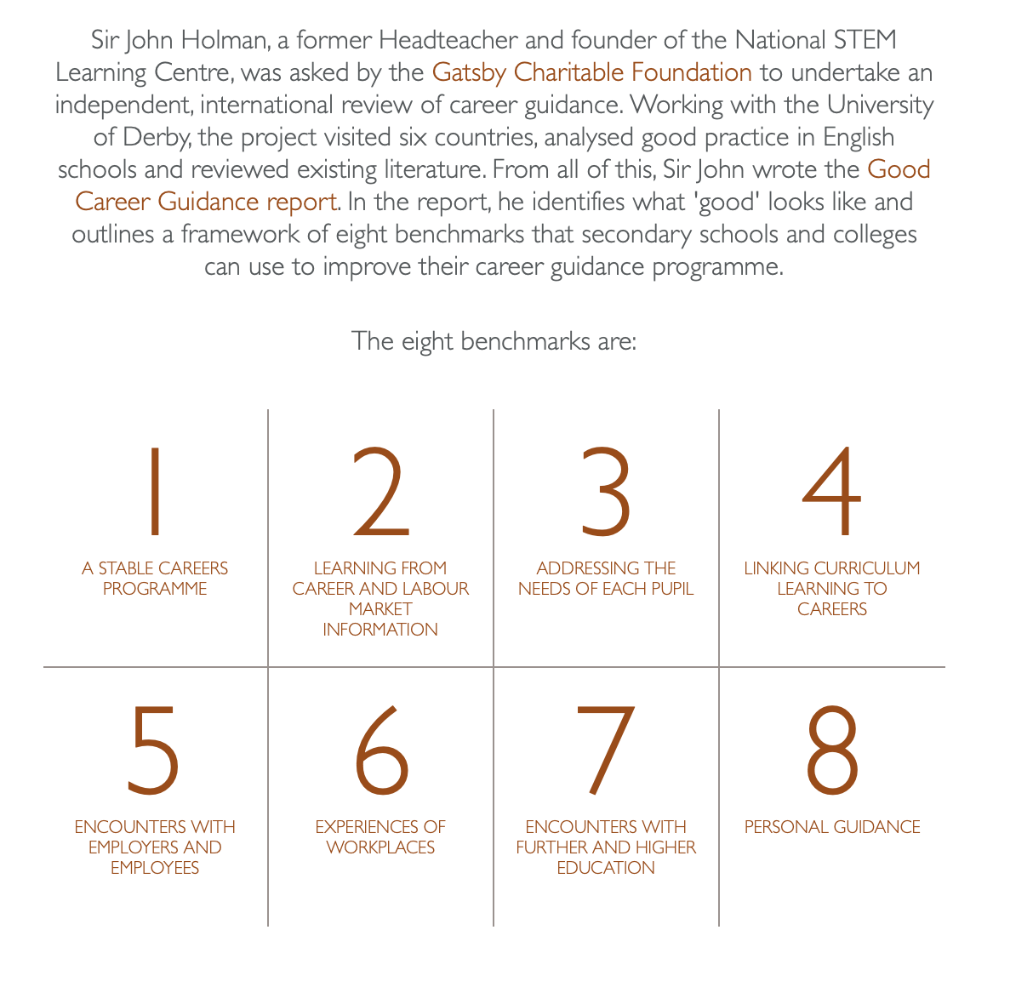
The Gatsby Benchmarks
​The 8 Gatsby Benchmarks are:
A stable careers programme ​
Learning from careers and labour market information ​
Addressing the needs of each student
Linking curriculum learning to careers
Encounters with employers and employees
Experiences of workplaces
Encounters with further and higher education
Personal guidance
The Careers & Enterprise Company resources to support the Gatsby Benchmarks.
Notes:
The Gatsby Benchmarks were developed on behalf of the Gatsby Foundation by Sir John Holman.
They define what world class careers provision in education looks like and provide a clear framework for organising the careers provision at your school or college.
The benchmarks are enshrined in statutory guidance and as a Careers Leader, it is your responsibility to oversee the implementation of the benchmarks in your education setting.

Slide 4
The Gatsby Benchmarking Tool
Compass is a free tool for schools and colleges in England, that quickly and easily helps you to evaluate your careers activity against the eight benchmarks of best practice – known as the Gatsby Benchmarks.
The tool was built in partnership with the Gatsby Charitable Foundation, to help you easily discover your strengths and find areas for improvement. Once completed, the tool will provide you with a confidential report and resources to help you achieve each benchmark.
https://compass.careersandenterprise.co.uk/info
Notes:
https://compass.careersandenterprise.co.uk/info

Slide 5
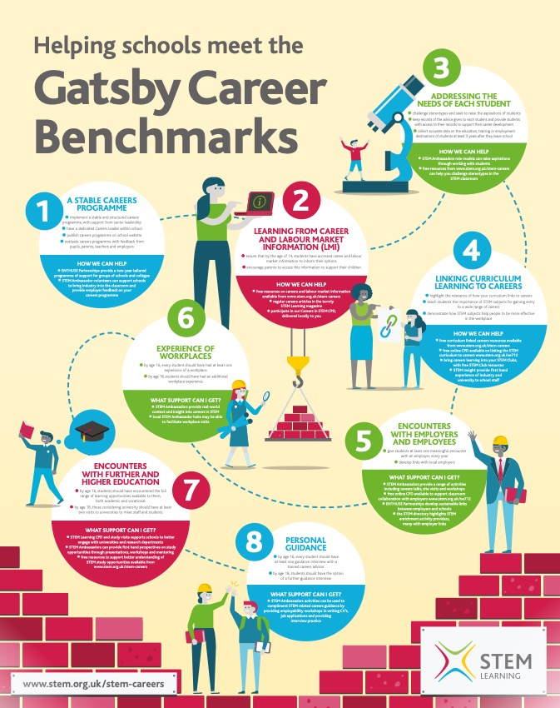
Activity:
How does physics fit within the Gatsby benchmarks in your school?
What specific action could you take to improve physics uptake for each of the Benchmarks?
(5 minutes)
https://www.stem.org.uk/resources/elibrary/resource/443831/helping-you-meet-gatsby-career-benchmarks#&gid=undefined&pid=1
Notes:
https://www.stem.org.uk/career-benchmarks

