Slide 1
Bitesize Physics Careers Resource
Improving the uptake in physics:
The Science Capital approach

Slide 2
Aims for this session
We will:
Review the Science Capital approach to teaching

Slide 3
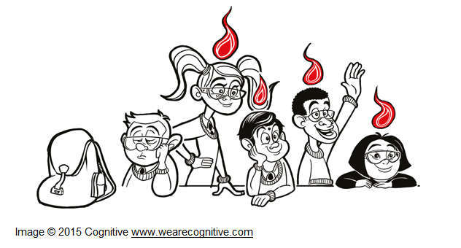
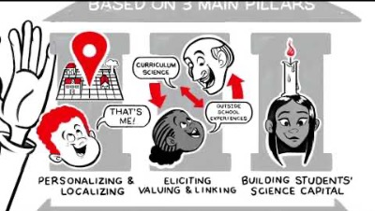
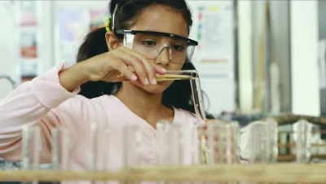
Seeing the bigger picture through the Science Capital approach
“Science capital refers to science-related qualifications, understanding, knowledge (about science and ‘how it works’), interest and social contacts (e.g. knowing someone who works in a science-related job).”
(ASPIRES, 2013)
You can find out more about the Aspires project here.
Some further background research can be found here.
Notes:
Building on the point we discussed earlier is this the idea that young people often cannot relate to physics is the concept of students’ self-efficacy in science or whether they see themselves as relating to science.

Slide 4
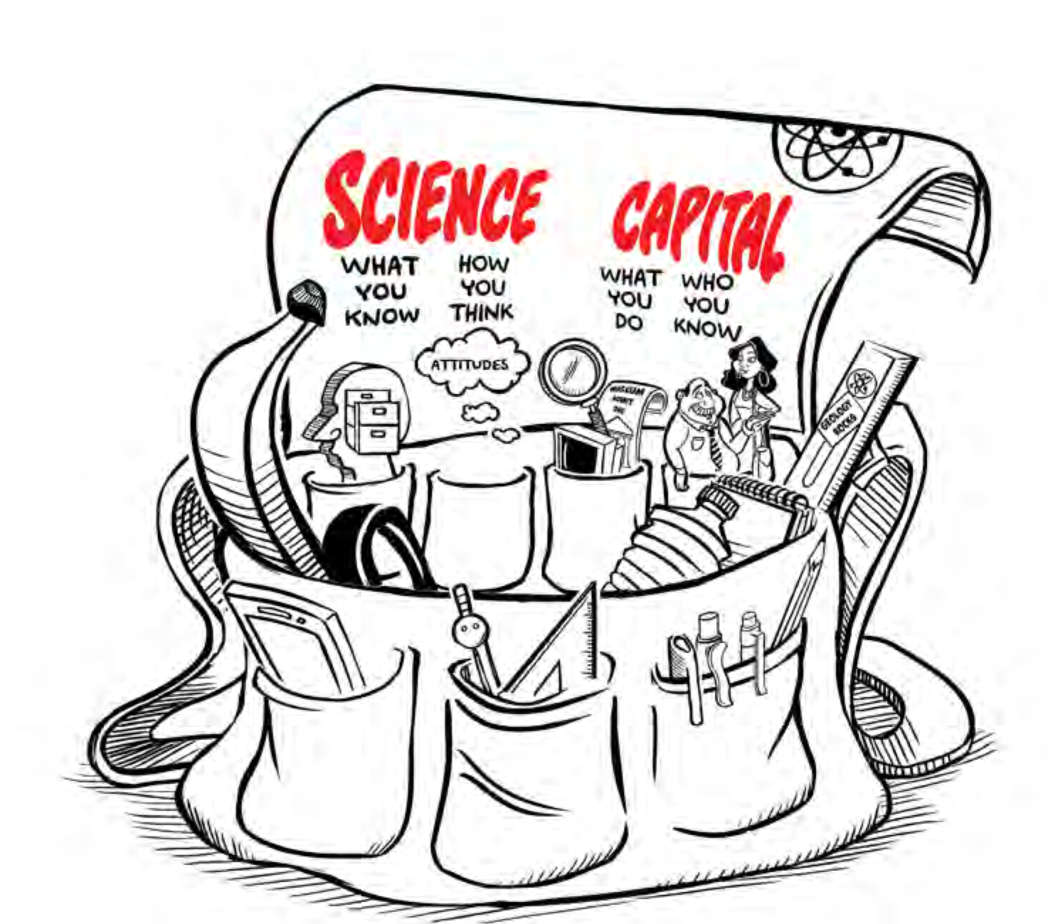
The ideas behind Science Capital
Science capital incorporates an individual’s science-related resources and their habitus, or attitudes and way of thinking.
It can be useful to think of science capital as a bag you carry throughout life that contains all your science or even STEM related knowledge (what you know), attitudes (what you think), experiences (what you do) and contacts (who you know).
Notes:
The concept of science capital draws on the work of sociologist Pierre Bourdieu (1977, 1984, 1986, 1990) and his theories of capital, habitus and field.
Capital describes the social, cultural and economic resources that an individual may have and is able to use to ‘get on’ in life.
Habitus refers to attitudes, dispositions and ways of thinking that are acquired through social experiences at home, in the community and at school. Habitus gives an individual a feel for the world, such as what is considered to be possible, desirable and thinkable.
Habitus and capital only exist and make sense within a particular field.
Field encompasses not just the physical setting but also the range of social relations, expectations and opportunities in a given environment. Field plays a key role because it determines whether or not an individual’s resources and ways of thinking are valued.

Slide 5
The Science Capital teaching approach: A quick overview
The science capital teaching approach is based on the foundation of broadening what counts and the three pillars: personalising and localising, eliciting, valuing and linking and building the science capital dimensions.
Useful links:
Aspires Research
Notes:
The challenge of how to engage all students is a long standing educational concern – not just in science, but across all subjects.
However, the historical culture of science
(for instance, popular views of scientists as white, male and middle-class) can mean that engagement issues are amplified.
While this is an enduring challenge, evidence shows that individual science teachers can make a difference in their own classrooms.
Aspires Research

Slide 6

FOUNDATION:
Broadening what counts
Teachers broaden what counts by:
Establishing class ground rules where all student contributions are welcome and respected.
Regularly reviewing student participation and ensuring that certain students do not dominate or prevent others from speaking.
Creating opportunities for students to express themselves in ways they feel comfortable.
Highlighting the scientific nature of different sorts of contributions.
Talking about different types of people who work in science or science-related jobs, showcasing examples in wall displays.
Helping to broaden students’ views of what counts as doing science in the classroom – so that curiosity, questioning, sharing experiences and relating to science through personal experience are valued. It’s not just about getting the right answer.
Challenging the stereotype that science is only for certain sorts of students.
Regularly discussing ways to encourage more students to participate with colleagues.

Slide 7
PILLAR ONE:
Personalising and localising
Teachers personalise and localise by:
Building on their knowledge of students’ interests, aspirations, local communities and past experiences.
Using examples and settings that are familiar and local to students as ‘hooks’ into the science content.

Slide 8
PILLAR TWO:
Eliciting, valuing and linking
Teachers elicit, value and link by:
Inviting students to think about and share their own experiences or ways of understanding.
Regularly using open questions.
Sharing relevant examples from their own personal life experiences to help create an environment where all sorts of contributions are valid.
Finding ways of including quiet or shy students, such as allowing them to work in pairs or small groups prior to talking in front of the whole class, or accepting written contributions.
Being prepared to follow up on a student comment or question. Comments can be indicative of a student’s personal interest, and may also be of relevance to others in the class.

Slide 9
PILLAR THREE:
Building the science capital dimensions
Teachers build the science capital dimensions by:
Developing scientific literacy
Promoting science-related attitudes, values and dispositions
Developing knowledge about the transferability of science
Understanding science media consumption
Participating in out-of- school science learning
contexts
Using family science skills, knowledge and qualifications
Knowing people in science-related roles
Talking about science in everyday life
More detailed resources can be found here, courtesy of UCL.
Notes:
More detailed resources can be found here, courtesy of STEM Learning.

Slide 10
Could your school benefit from the Science Capital approach?
Activity:
Discuss whether the science capital approach is useful for your school and whether you already have incorporated any of the ideas into your physics careers messaging.
(3 minutes)
Summarise where your schools approach overlaps and any ideas you would like to take forward
(2 minutes)

