Slide 1

Bitesize Physics Careers Resources
Improving the uptake in physics:
Why should we promote physics careers

Slide 2
Aims for this session
We will consider:
The challenges in physics and why we should promote physics careers

Slide 3
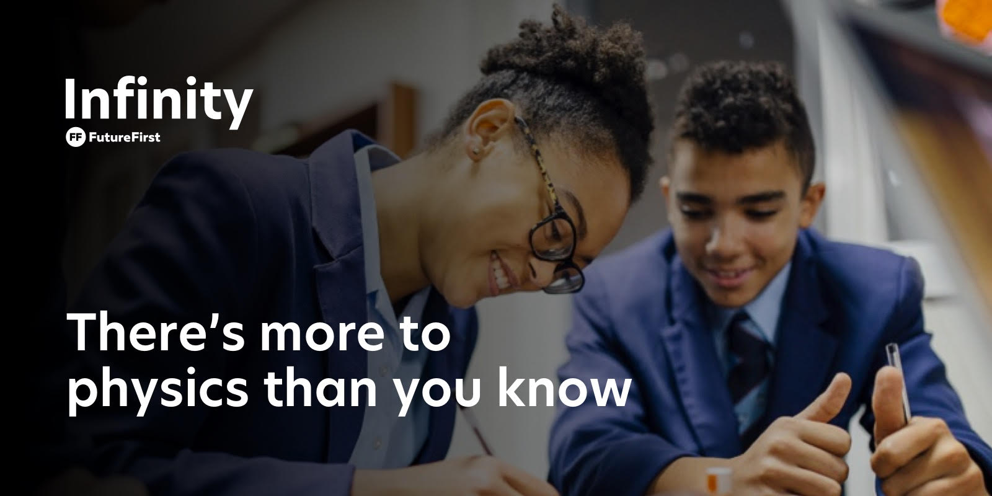
What is physics?
Broadly, physics involves the study of everything in physical existence, from the smallest subatomic particles to the entire universe.
Not only that, Physics teaches people to understand and solve complex problems. Not just on paper or in theory. The kind of problems that exist everywhere in the world, waiting to be solved. There are no limits to what can be achieved with physics.
Notes:
Physics as well as being an academic subject it is also the incorporated in many vocations
Physics skill are sought after in engineering, medicine, computing, finance as well as for trades such as a builder, electrician or plumber.

Slide 4
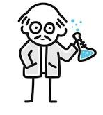
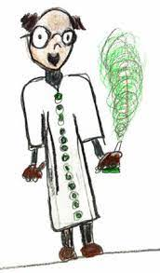
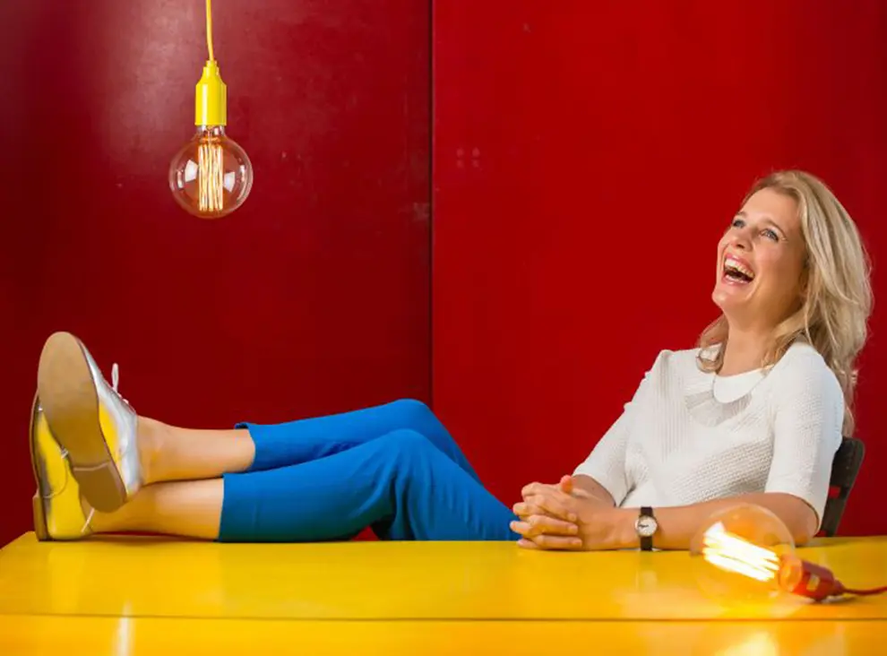
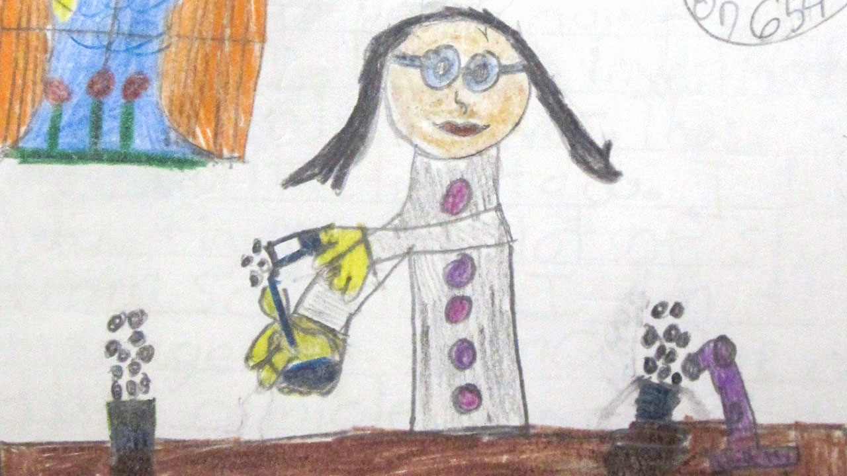

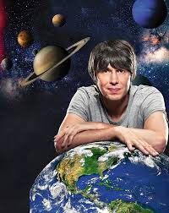

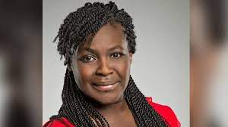
The image of physics
Prof. Danielle George Electrical Engineer
What does a scientist look like? Children are drawing women more than ever before
Dr Maggie Aderin-Pocock:
Space Scientist
Prof Albert Einstein
Prof Brian Cox
Notes:
What does a scientist look like? Children are drawing women more than ever before
Unfortunately, some young people are put off by the misconceived ideas they are told about what physics is and if they continue in a physics career. Others are denied the opportunity to study physics due to the prejudice and stereotypes that they experience because of who they are.
As a result, too many young people are made to feel that they can’t do physics, or they just don’t fit in. This is a problem because when young people are deterred from studying physics, they are missing out on the many benefits that studying physics brings.
Crucially, they are also being denied the opportunity to explore how their world works and contribute to shaping their future as informed citizens.

Slide 5
The image of physics
“I was told I was not smart enough for physics and that if I didn’t want to be an engineer there was no point.”
“Physics is not for everyone.”
“Physics to me was always for the privileged; for those who can afford time.”
“Our physics teacher told us that girls don't do as well in physics.”

Slide 6
Examples of some of the challenges in improving uptake in physics
This graph shows the number of students choosing A-level physics across state schools in England in 2019. For 302 schools, not one of their students pursued A-level physics.
At the other end of the scale, there are about 20 schools from which more than 50 students chose physics.

Slide 7
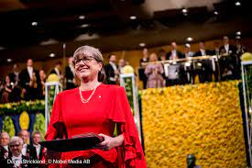
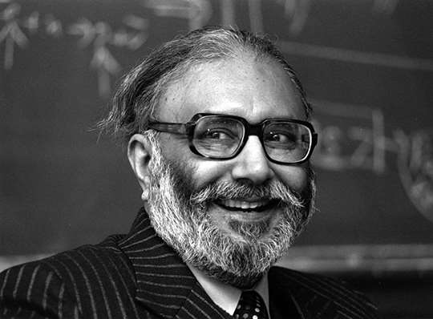
Professor Donna Strickland: Recipient of the Nobel Prize in Physics 2018. she found a way to create high-intensity laser pulses. ed to the development of the field of high-intensity ultrashort pulses of light beams.
The physicist Abdus Salam is considered one of the greatest scientists of the 20th century. He was the first Pakistani to win a Nobel Prize and the first Muslim to win one in the sciences for his contribution to the electroweak unification theory.
Source: IOP Limitless Campaign
Notes:
Limitless
Women and BME groups are underrepresented in Physics. This forms the basis of the IOP’s Limitless campaign which is attempting to address these issues.

Slide 8
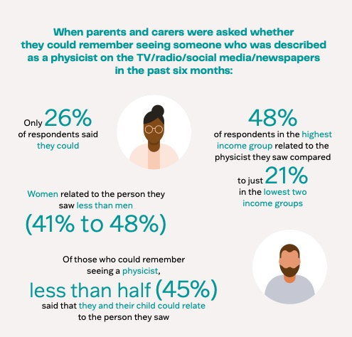
Parent and carer responses to physics are related to income groups.
Source: IOP Limitless Campaign
Notes:
The last statistic is also perhaps one of the reasons why many young people do not pursue physics.

Slide 9
Clearly, schools have a vitally important role in careers education.
Source: IOP Limitless Campaign
Notes:
Teachers are crucial to encouraging more young people from underrepresented groups to study physics in school and consider a career using physics.
Educators in nurseries and schools must see young people as individuals so that they can be helped to realise their full potential and be supported to make their own choices.
Unfortunately, some educators make assumptions about young people based on their ethnicity, gender identity, disability, sexual orientation and social background rather than who they are as individuals. By expressing their own conscious or unconscious biases, these educators discourage young people from exploring all of their possibilities.
This is by no means a new problem, but it is a problem that demands our urgent attention. Attainment gaps between girls and boys, disadvantaged young people and their peers, and young people of different ethnicities have persisted for too long. As these attainment gaps grow wider, not closer, we must act now to build a better, more equitable education system for all.
However, many schools have few or no specialist physics teachers. How do young people then get up to date information about where physics can take them?

Slide 10
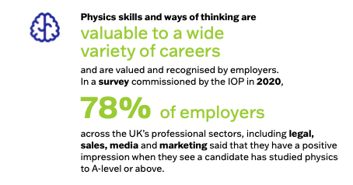
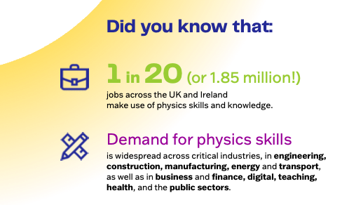
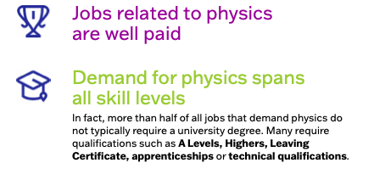
Why we should promote physics careers?
People don’t always understand the range of careers that study in physics can enable. Physics is a subject, a discipline but also integral to STEM related careers.
Source IOP Limitless campaign: https://www.iop.org/strategy/limit-less
Notes:
Young people and their families need to know the positive benefits of continuing with physics. This could be either through study or an apprenticeship or technical role. They need to know that studying physics doesn’t narrow career opportunities but opens doors to jobs in many sectors.
More also needs to be done to make sure young people know about the contribution that physics makes to our society and the opportunities it gives them to change their world.
(Refer to website)
Source IOP Limitless campaign: https://www.iop.org/strategy/limit-less

Slide 11
How is physics positioned in your school?
Activity:
Think about all the ways in which is physics is conveyed to students in your school
You might consider:
  How is the subject positioned, who champions the subject?
  Which students study it?
  Have you got specialist subject teachers in physics?
  What do other colleagues and departments know about the subject?
(3 minutes)
Do you have any ideas to better promote physics in your school? Please be ready discuss and note your ideas for future reference.
(3 minutes)
Notes:
Does physics have a defined identity within your school? Is it simply viewed as part of science or is it promoted as a distinct subject?
It is important to consider this question and how the subject may be better communicated as an academic subject but also as a pathway to many vocational careers.

